Slide 1
Python Development with PyCharm IDE

Slide 2
ToC
Creating a Project
Creating a Python File
Look around and customize the environment(TODOs, Editor, Terminal, Structure, etc.)
Configure interpreter (virtual environment)
Features:
Auto completion/Suggestions, Navigating across files, Creating Scratch file, pycharm shortcuts(Reformat code, Folding)
Running a Python Script
Debugging using breakpoints

Slide 3
Step 0
In general to start developing in Python with PyCharm you need to download, install and start PyCharm.

Slide 4

Creating a Project
PyCharm Community 2018.1 is Starting

Slide 5
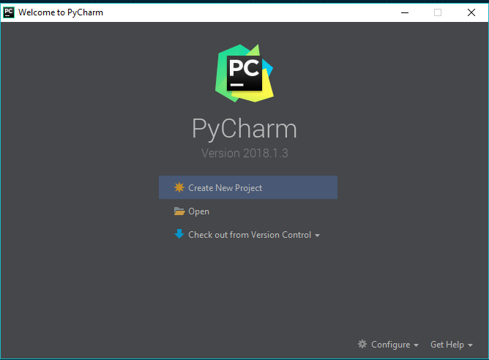
Creating a Project
Click on “Create New Project” to start a new project.

Slide 6
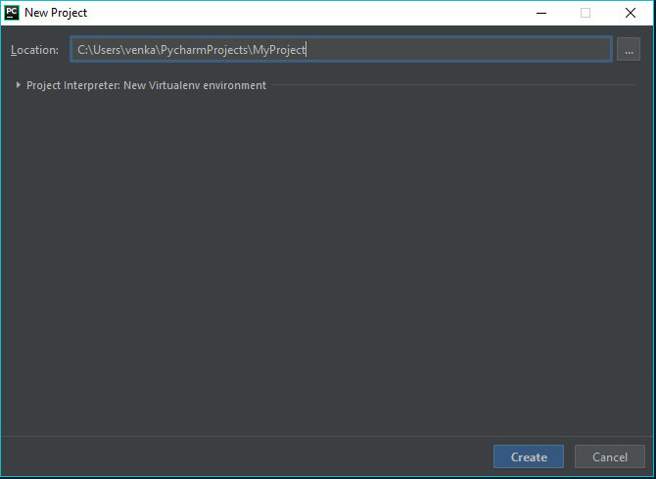
Creating a Project
Give the path where you want to save your project with name.
Generally, it will save in PycharmProjects folder.
For Ubuntu, it will save in /home/user_name/PycharmProjects
For Windows, it will save in C:\Users\user_name\PycharmProjects

Slide 7
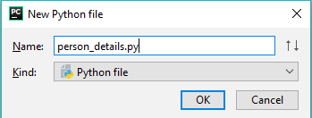
Creating a python file
Let’s create a python file with name “person_details.py”.
Right click on MyProject → New → Python File and type the name “person_details.py”

Slide 8
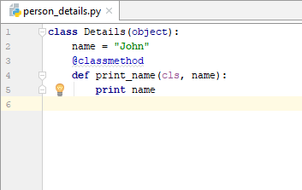
Writing code in file
Let’s write some code to execute.
For example, let’s create attribute “name” with some default value and a method to print the name.

Slide 9
PEP Guidelines
Developers always need to share their code, so it is very important for that code to be easily understood by others. And here come different coding style guides and standards. One of them, PEP 8, is the de facto coding style guide for Python.
PyCharm 2.7 takes care of readability and general beauty of your code. Now it supports continuous checking of your code for PEP 8 compliance on the fly, as you type it in the editor.
Notes:
https://blog.jetbrains.com/pycharm/2013/02/long-awaited-pep-8-checks-on-the-fly-improved-doctest-support-and-more-in-pycharm-2-7/

Slide 10
Look around
When a project is opened, you see the main window divided into several logical areas.
Let’s take a moment to see the key UI elements.
Project view
Editor
Navigation bar
Left gutter
Right gutter
Tool windows
The status bar

Slide 11
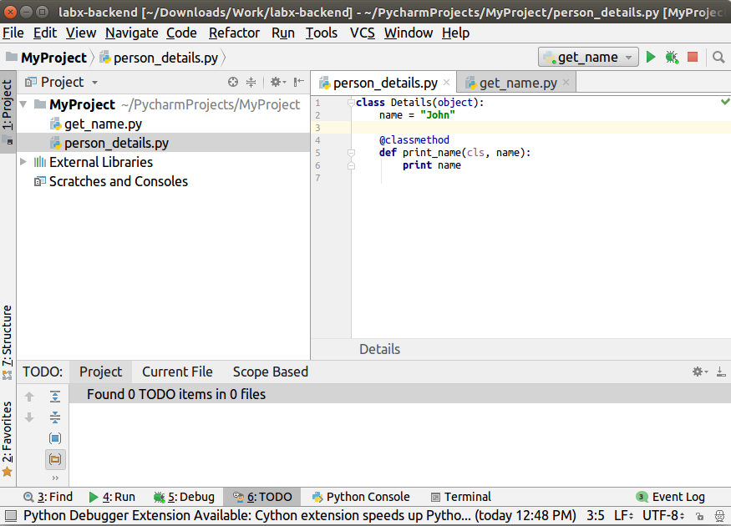
Look Around
3
5
4
2
1
6
7

Slide 12
Project view
Project view on the left side displays your project files.
1

Slide 13
2. Editor
Editor on the right side, where you actually write your code. It has tabs for easy navigation between open files.
2

Slide 14
3. Navigation Bar
Navigation bar above the editor additionally allows you to quickly run and debug your application as well as do the basic VCS actions.
3

Slide 15
4. Left gutter
Left gutter, the vertical stripe next to the editor, shows the breakpoints you have, and provides a convenient way to navigate through the code hierarchy like going to definition/declaration. It also shows line numbers and per-line VCS history.
4

Slide 16
5. Right gutter
Right gutter, on the right side of the editor.
PyCharm constantly monitors the quality of your code and always shows the results of its code inspections in the right gutter: errors, warnings, etc.
The indicator in the top right-hand corner shows the overall status of code inspections for the entire file.

Slide 17
6. Tool windows
Tool windows are specialized windows attached to the bottom and sides of the workspace and provide access to typical tasks such as project management, source code search and navigation, integration with version control systems, etc.
6

Slide 18
7. The status bar
The status bar indicates the status of your project and the entire IDE, and shows various warnings and information messages like file encoding, line separator, inspection profile, etc.
7

Slide 19
Some Features in PyCharm

Slide 20
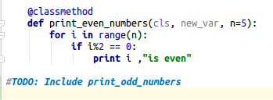
TODO
PyCharm suggests to use special TODO comments in the source code. Such comments can be used in all supported file types, and should match a certain TODO pattern.
For example, default pattern is “TODO: statement” as a comment.

Slide 21
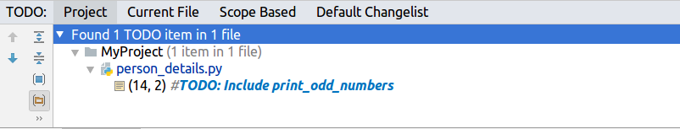
TODO
You can see all TODOs in the TODO tool which is present in the Tool window.

Slide 22
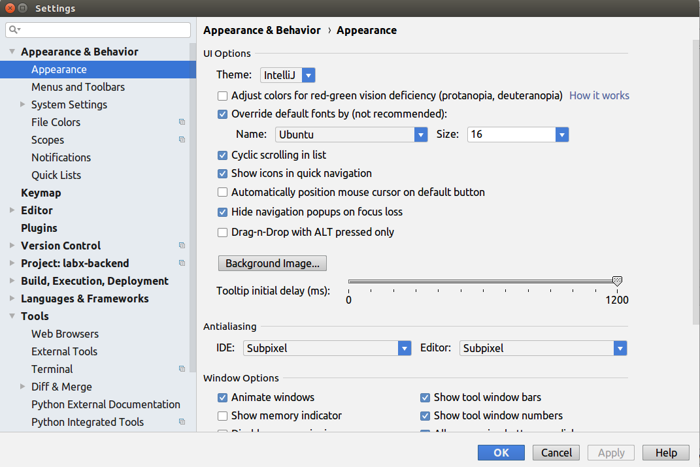
Customize your environment
Appearance
To configure the appearance, go to File → Settings → Appearance and Behaviour → Appearance

Slide 23
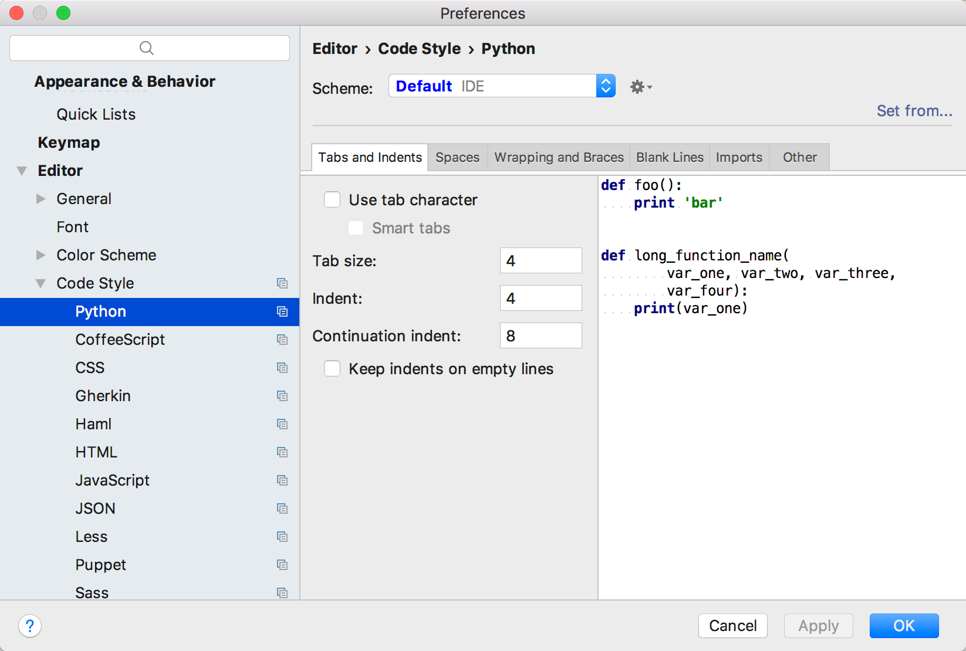
Customize your environment
Code Style: Code style can be defined for each language. You can also create and save your own.
Go to File → Settings → Editor → Code Style

Slide 24
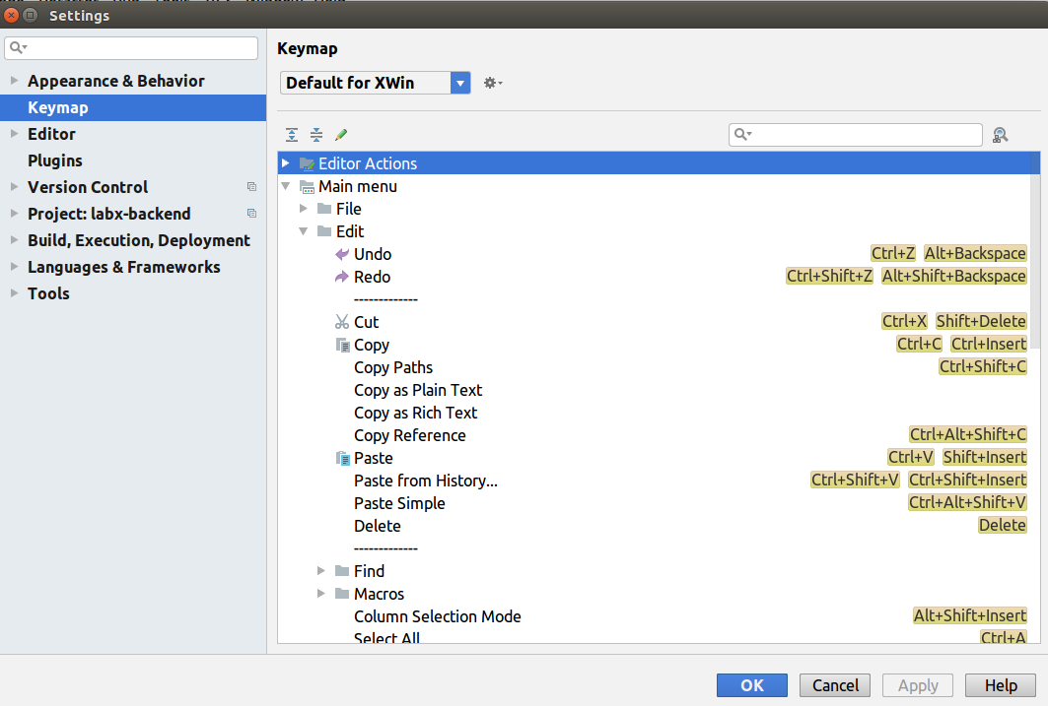
Customize your environment
Keymap: PyCharm uses the keyboard-centric approach, meaning that nearly all actions possible in the IDE are mapped to keyboard shortcuts.
Go to File → Settings → Keymap

Slide 25
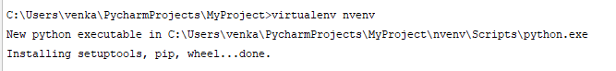
Creating a virtual environment
Virtualenvs help you keep the dependencies for your different projects separate. Let’s create a virtual environment with name “nvenv” with the code: virtualenv nvenv

Slide 26
Auto completion/suggestions
Code completion is a great time-saver, regardless of the type of file you’re working with.
Basic completion works as you type and completes any name instantly.
Smart type completion analyzes the context you’re currently working in and offers more accurate suggestions based on that analysis.
There are many types of auto completions available. Let’s see about base completion and smart type completion.

Slide 27
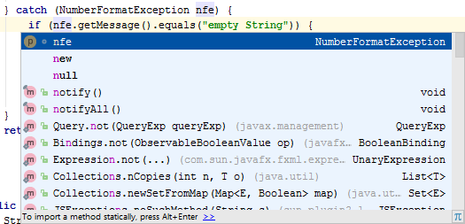
Basic completion
Basic code completion helps you complete the names of classes, methods, fields, and keywords within the visibility scope.
To invoke Basic completion, press “Ctrl+Space” or go to Code → Completion → Basic

Slide 28
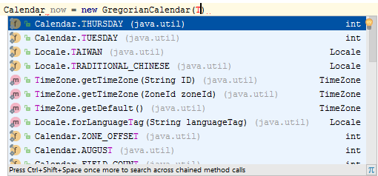
Smart completion
Smart code completion filters the suggestions list and shows only the types applicable to the current context.
To invoke smart completion, press Ctrl+Shift+Space or go to Code → Completion → SmartType

Slide 29
Code refactor
Refactorings can be a simple rename of a variable or extracting a superclass from the body of an existing class.
PyCharm provides many refactorings for the various languages it supports. It carries them out automatically, making sure existing code is updated and will not break.

Slide 30
Reformatting the Code
PyCharm lets you reformat source code to meet the requirements of your code style. PyCharm will lay out spacing, indents, keywords etc.
To reformat code, go to Code → Reformat Code or press Ctrl+Shift+Alt+L

Slide 31
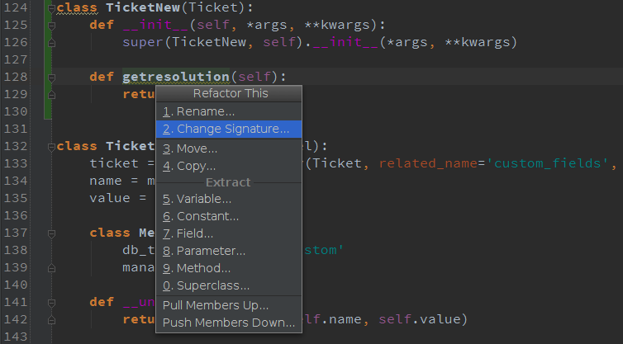
Code refactor
To see refactoring options, right click on the files, editor or on some code and select refactor.
You can see Rename, Change Signature, Move, Copy, etc.

Slide 32
Change Signature Refactoring
Let’s see “Change Signature” refactoring which combines several different modifications that can be applied to a function signature.
You can use this refactoring for the following purposes:
To change the function name.
To add new parameters and remove the existing ones.
To assign default values to the parameters.
To reorder parameters.

Slide 33
Change Signature Refactoring
When changing a function signature, PyCharm searches for all usages of the function and updates all the calls, implementations, and override replacements of the function that can be safely modified to reflect the change.

Slide 34
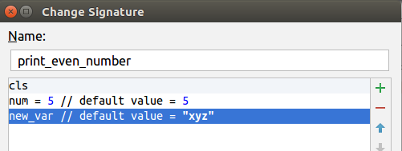
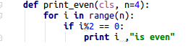

Change Signature Refactoring
For Example, let’s write a code to print even numbers.
Before: After:

Slide 35
There are so many features included in PyCharm. You can explore them in the PyCharm interface or refer it’s guide:
https://www.jetbrains.com/help/pycharm/quick-start-guide.html

Slide 36
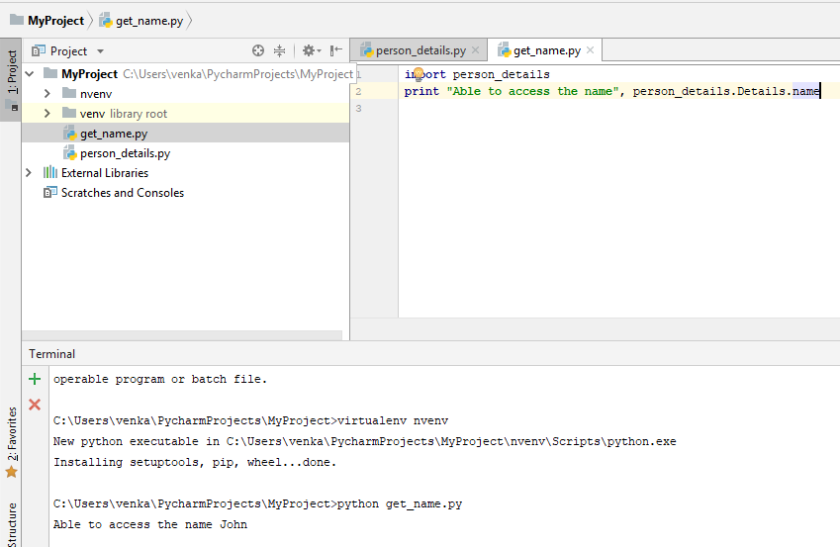
Importing class from another file
Let’s import person names from the “Details” class in person_details.py to a new file get_name.py.

Slide 37
Run, Debug & Test
When you perform run, debug, or test operations with PyCharm, you always start a process based on one of the existing run/debug configurations, using its parameters.
Go to Run → Run/Debug → Configurations dialog → Edit Configurations to see all the available options.

Slide 38
Running a python script
In Terminal, let’s run the get_name.py file and check.
Here, we are able to access the name attribute from previous class.
The easiest way to run an application is to right-click its background in the editor, and then choose Run <name>

Slide 39
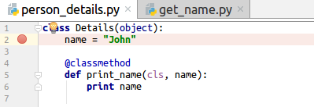
Debugging using breakpoints
Does your application stumble on a run-time error? To find out what’s causing it, you will have to do some debugging. PyCharm supports the debugger on all platforms.
Debugging starts with placing breakpoints at which program execution will be suspended, so you can explore program data. Just click the left gutter of the line where you want the breakpoint to appear.

Slide 40
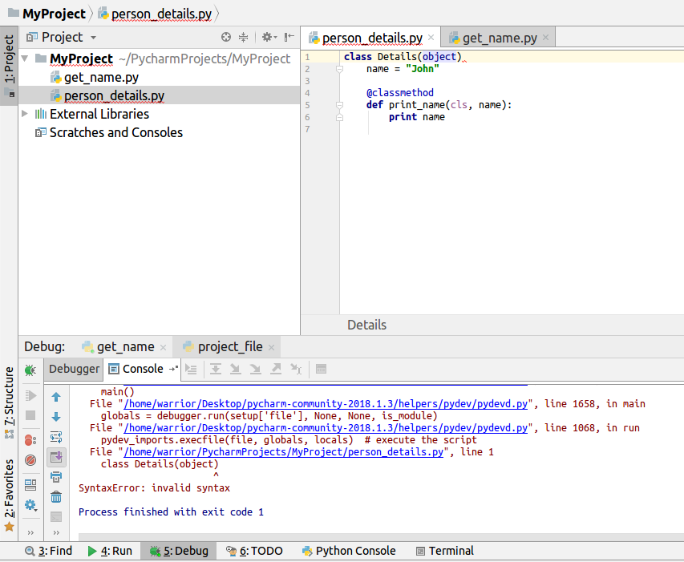
Debugging
To see how it works, let’s remove some syntax in our code.

Slide 41
Debugging
To start debugging your application, press Shift+F9.
Then go through the program execution step by step (Go to Run → Debug), evaluate any arbitrary expression, add watches and manually set values for the variables.

Slide 42
Testing
It is a good idea to test your applications, and PyCharm helps doing it as simple as possible.

Slide 43
VCS
Git is a distributed version control system, so each machine has its own repository.
Step 1: Initialise the repository
Command: git init
Step 2: Add all your files to the repo:
Command: git add *
Step 3: Check status
Command: git status
Step 4: Commit the changes
Command: git commit -m “first commit”

Slide 44
END

